Slide 1

Assignment-I: CARE WITH CARE HOSPITAL
Web Development Framework Using Python (23AI002)
Submitted by: GAURI CHOPRA (2310993822)
Submitted To: Dr. Swati Malik
CHITKARA UNIVERSITY INSITUTE OF ENGINEERING & TECHNOLOGY CHITKARA UNIVERSITY, RAJPURA
FEBRUARY, 2023

Slide 2


CARE WITH CARE
HOSPITAL

Slide 3

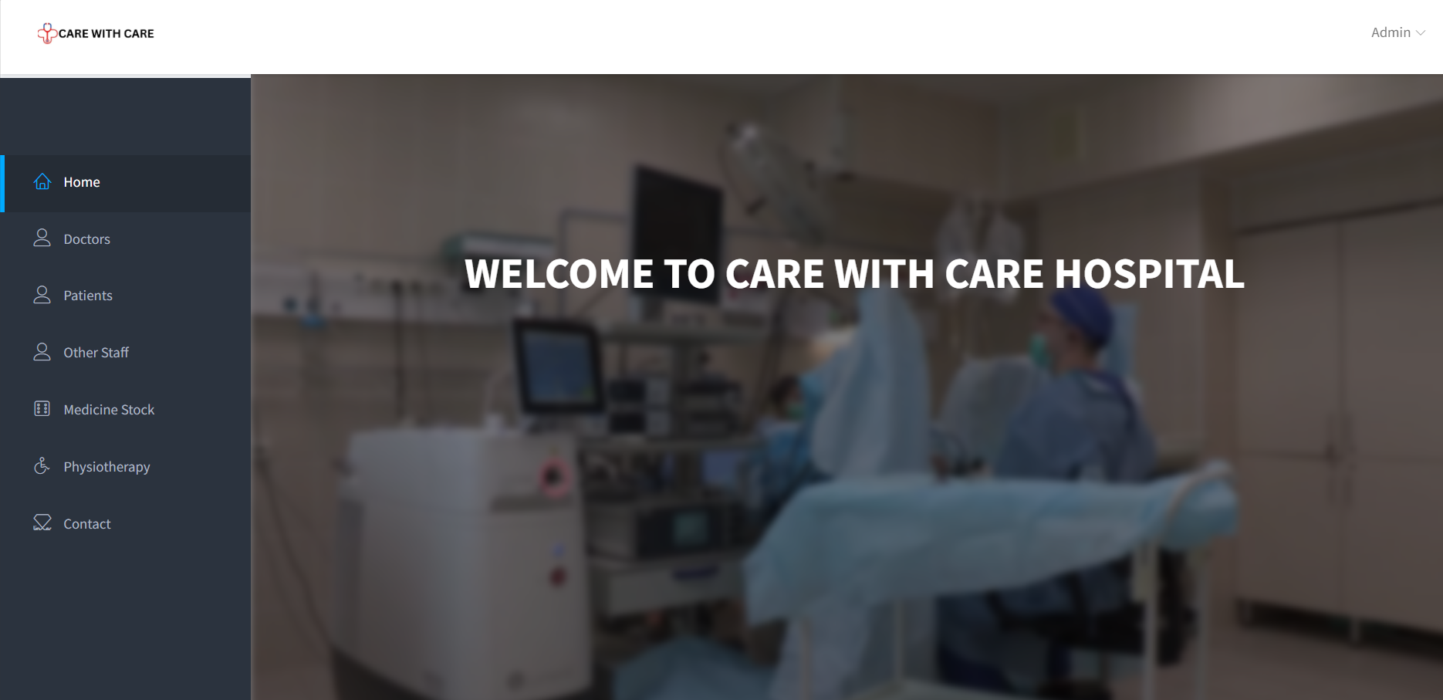
INTRODUCTION
Welcome to the “CARE WITH CARE” Administration System – an innovative solution designed to streamline and enhance administrative processes in the healthcare domain. This comprehensive administration platform serves as a centralized hub for managing crucial information related to doctors, patients, medicines, other staff, and physiotherapy services.

Slide 4

KEY HIGHLIGHTS

Slide 5

Dashboard containing all the details such as doctor details patient details and staff details
Background video depicting the features and ambience of the hospital

Slide 6

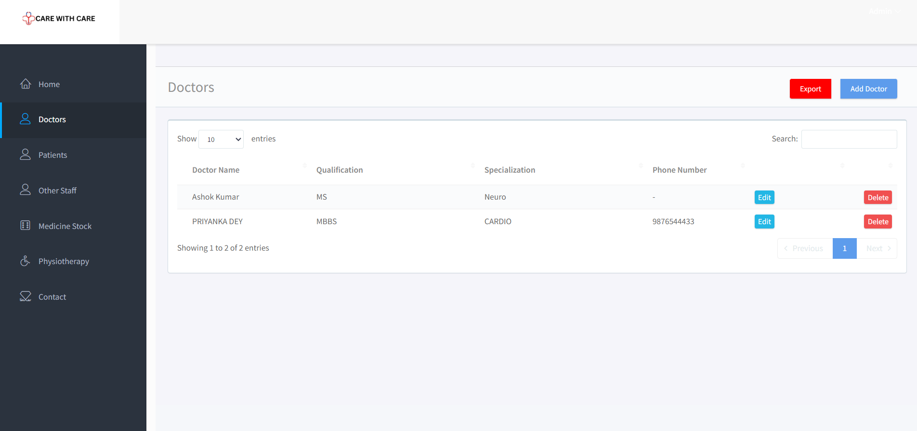
Doctor Management
Maintain detailed records of all doctors, including their qualifications and specialties.
Efficiently organize and access essential information about each medical professional.
Facilitates effective communication and collaboration among the medical team.

Slide 7

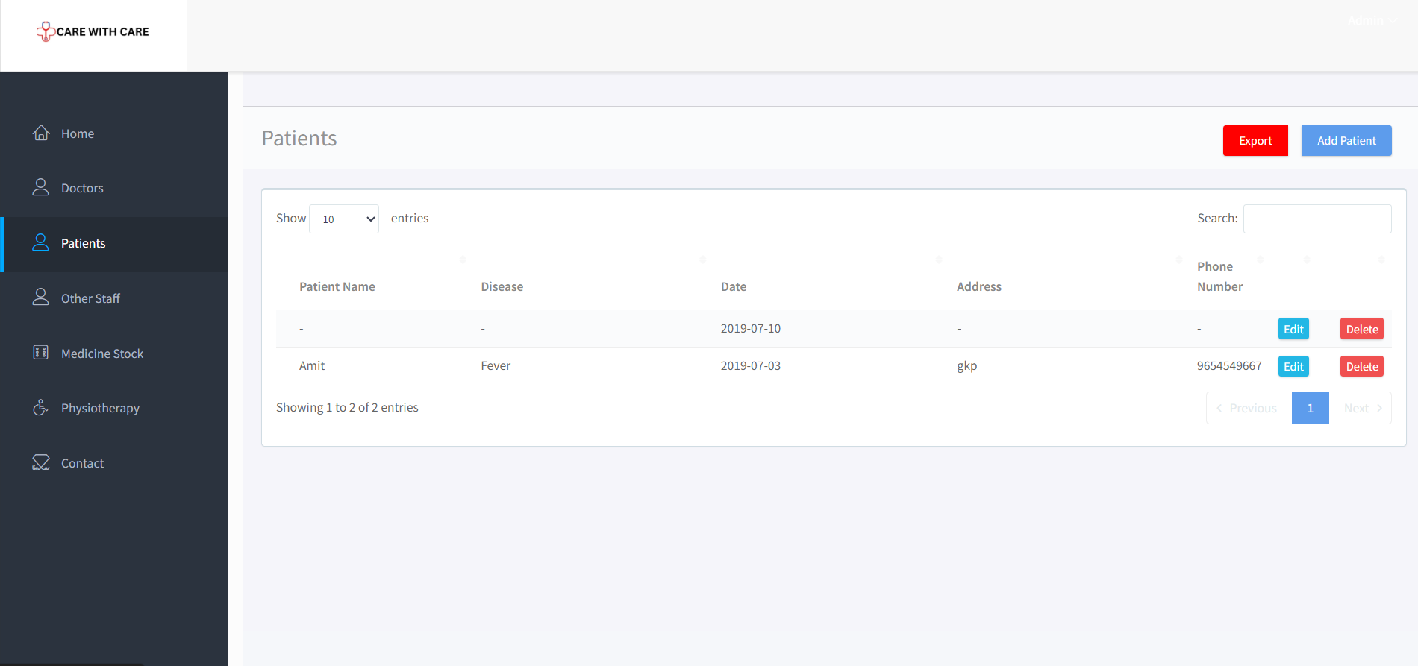
Patient Information
Comprehensive patient profiles with relevant details for personalized healthcare.
Easy access to patient history, diagnosis, and treatment plans for enhanced care.
Streamlined appointment scheduling and tracking for improved patient management.

Slide 8

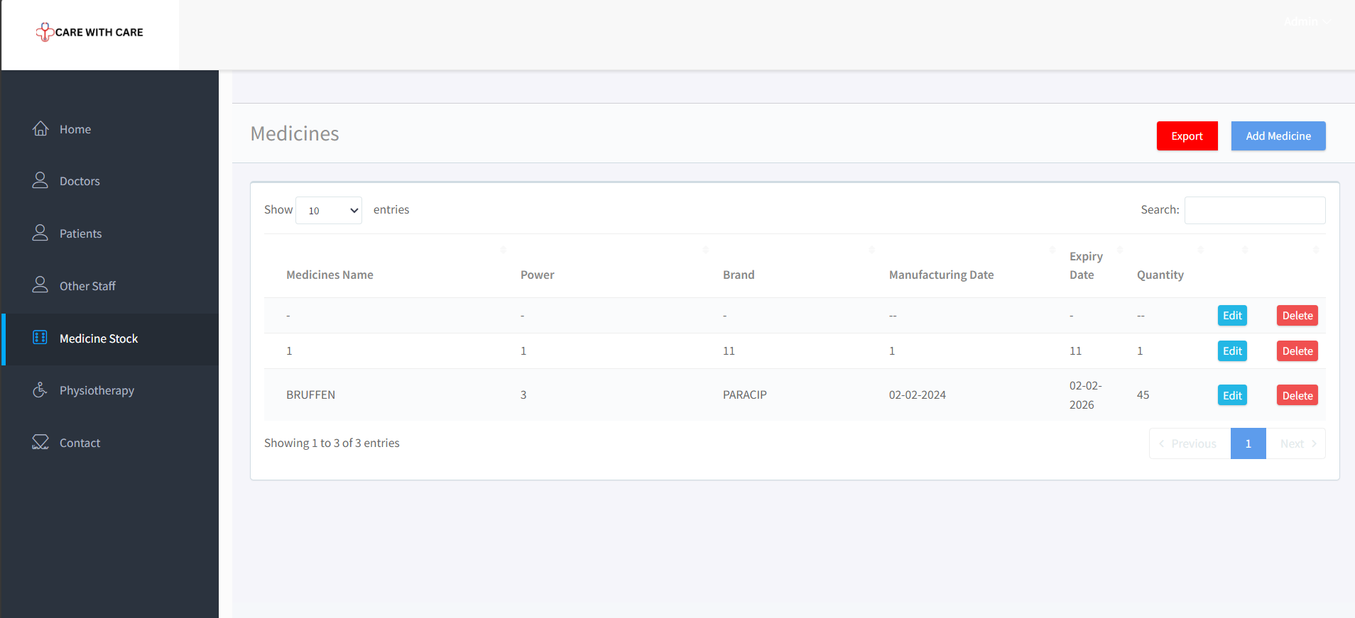
Medicine Inventory
Centralized database for monitoring and managing medicine stock.
Real-time updates on medicine availability, expiration dates, and restocking needs.
Ensures accurate medication tracking and minimizes the risk of shortages

Slide 9

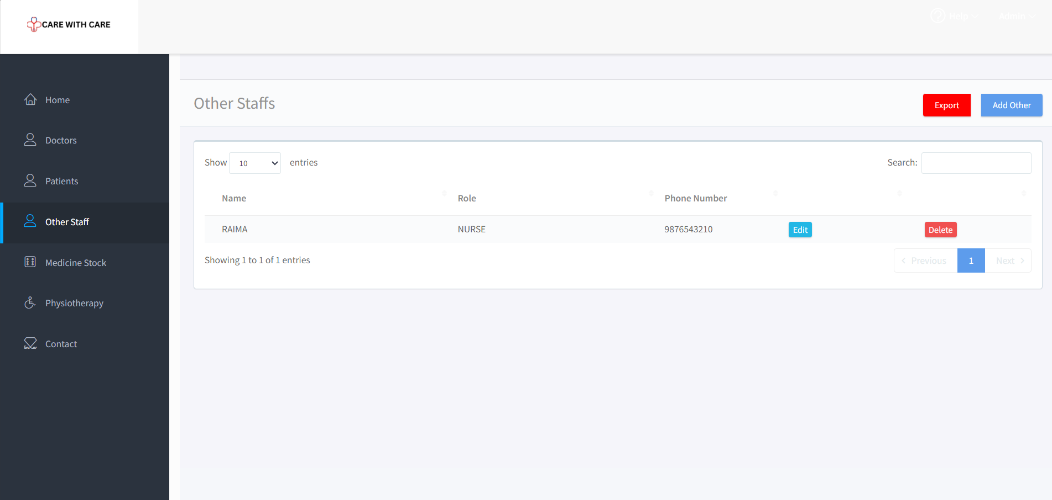
Other Staff Records
Detailed profiles of non-medical staff members, including roles and contact information.
Efficiently manage and coordinate activities of administrative and support personnel.
Enhances overall workflow and ensures smooth day-to-day operations.

Slide 10

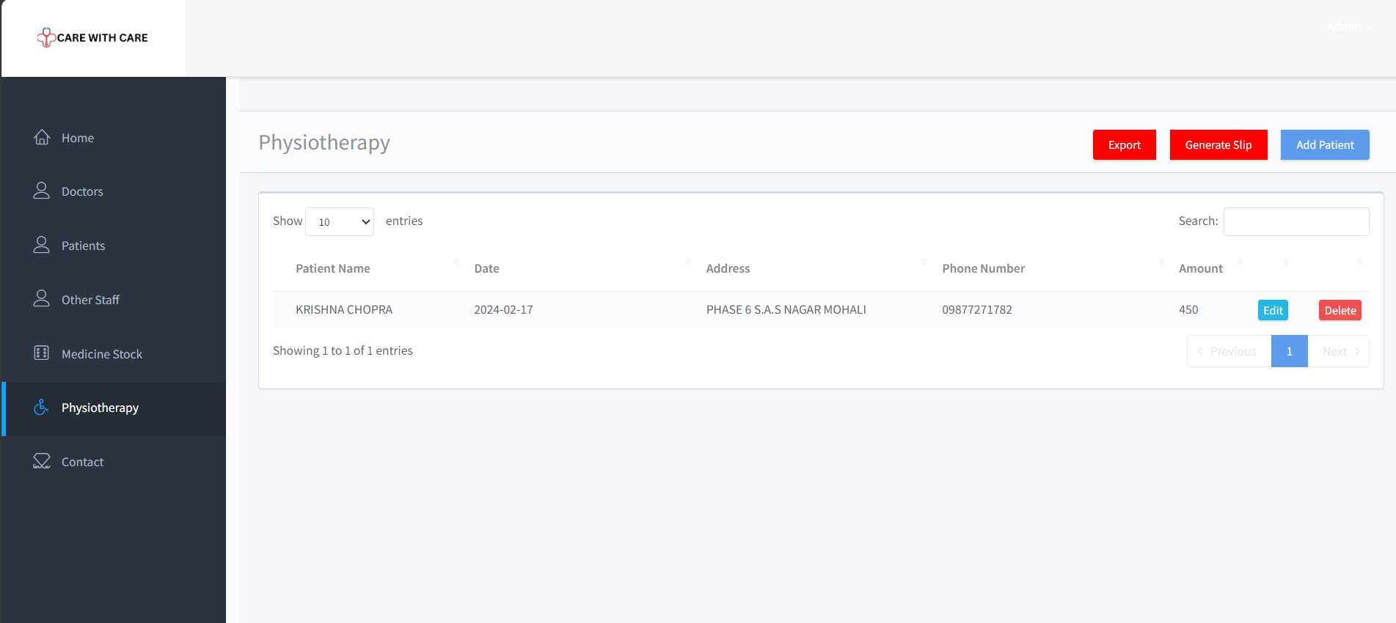
Physiotherapy Management
Dedicated section for tracking physiotherapy sessions and patient progress.
Integrated tools for physiotherapists to document treatment plans and outcomes.
Comprehensive insights into the effectiveness of physiotherapy interventions.

Slide 11

MAIN PART OF THE CODE

Slide 12
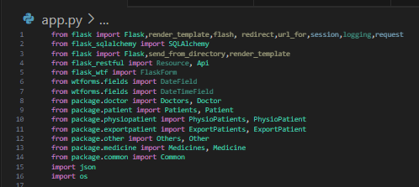

Slide 13
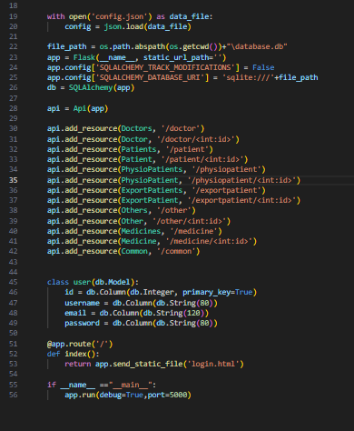

Slide 14
REFERENCES
OpenAI. (2021). “ChatGPT-OpenAI’s Language Model.”
GitHub. (2021). “GitHub Repository.”
Google. (2021). “Google Search”
4. Now. (2021). “Now by OpenAI.”

Slide 15

REFERENCES

